Slide 1


 | Nitte Meenakshi Institute of Technology (AN AUTONOMOUS INSTITUTION AFFILIATED TO VISVESVARAYA TECHNOLOGICAL UNIVERSITY, BELGAUM) PB No. 6429, Yelahanka, Bangalore 560-064, Karnataka Telephone: 080- 22167800, 22167860, Fax: 080 - 22167805
Department of Computer Science and Engineering
Application Development Using Low code/No Code Platform
Presentation By:
V Venkata Sree Harsha 1NT18CS181
Company Name: Paleetu Educon & Enablement Services

Slide 2
TABLE OF CONTENTS
 | Nitte Meenakshi Institute of Technology (AN AUTONOMOUS INSTITUTION AFFILIATED TO VISVESVARAYA TECHNOLOGICAL UNIVERSITY, BELGAUM) PB No. 6429, Yelahanka, Bangalore 560-064, Karnataka Telephone: 080- 22167800, 22167860, Fax: 080 - 22167805
Department of Computer Science and Engineering
Introduction
Background
Problem statement
Scope of the Work
Objectives of the work
System Requirements
Design
References

Slide 3
Introduction
Low-code Platform: Low-code development platforms are types of visual software development environments that allow enterprise developers and citizen developers to drag and drop application components, connect them together and create mobile or web apps.
These platforms are used in such a way that which can be developed the business level applications in a faster way.
Low-code platforms are building sites that are just as impressive as ones built by skilled developers, and do it in less than half the time of their counterparts. The low-code web design movements are going through a renaissance.

Slide 4
Background
WEM: WEM Modeler is low code platform where we can develop applications with less code and in faster way. This WEM applications (or) Websites are fully secured and having good efficiency. Some of the features of WEM are:
Built for security and scalability
WEM Low-No code equals Incredible Speed & Flexibility
Create documents, files, compute, automate, integrate
Securely integrate with anything. Rapidly. Easily.
Support for microservice architecture
Create beautiful customer experiences
Reduce Total Cost of Ownership

Slide 5
Scope of Work
This internship given me an experience how to built the applications or websites with low code platform. And also this WEM Modeler having variety of options such a way that we can develop a complete enterprise level application with drag and drop method. Main aim to develop this application lies behind the logic of the application what we make on the Kanban board.
And also WEM provides a lot of API’s which we can include in the application.
This WEM follows Agile Methodology where we can develop (or) debug the application at any stage of the built.
This WEM application can be run on any of the device, and also the interface of the WEM is user-friendly.

Slide 6
Objectives of Work
The main objective of the internship is get exposure of industry and also how to make an low-code application according to the customer requirement, and how to follow the SDLC method during the building of the application. And if the customer have any modifications in the application then managing the customer with his requirement and satisfying the customer requirement.

Slide 7
System Requirements
The System requirements for the WEM Modeler as follows:
Laptop (or) PC (Minimum of 4GB RAM)
Good Wi-Fi Connection (10Mbps is decent)
Account in WEM
Having built in Debugger of HTML, CSS, Java Script

Slide 8
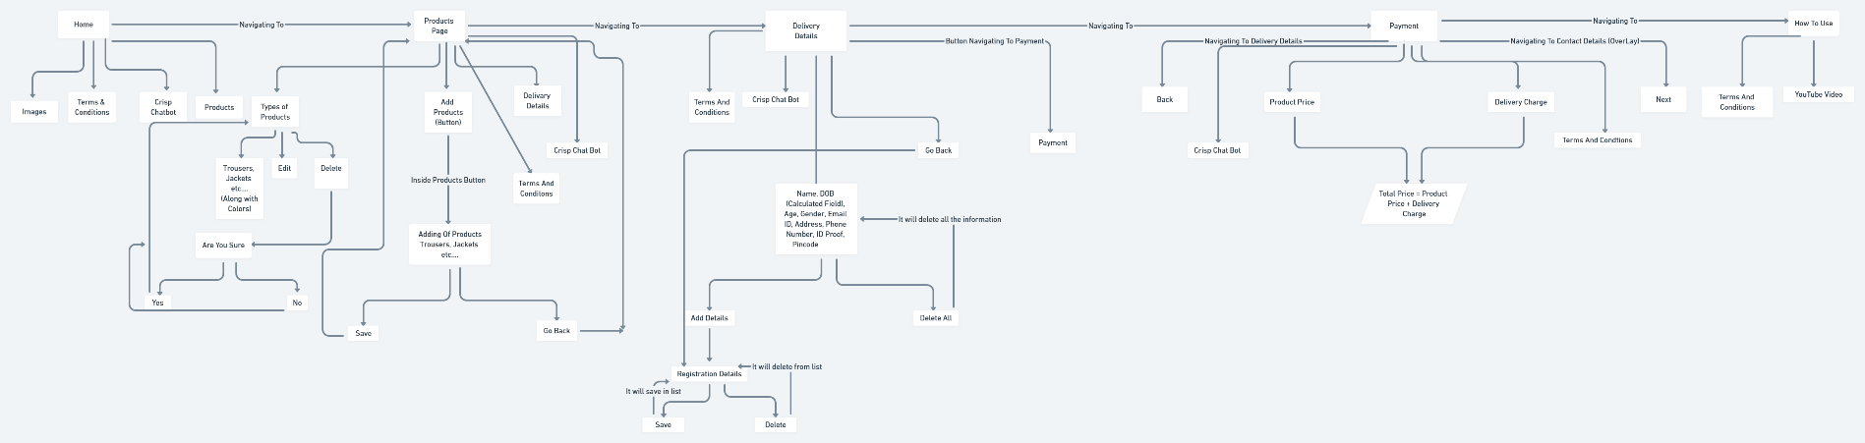
Requirement Phase

Slide 9
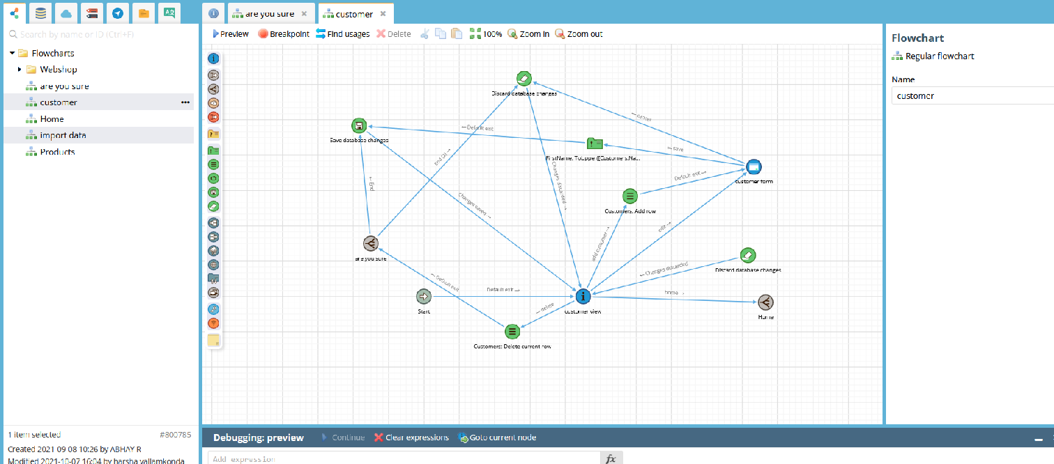
Design

Slide 10
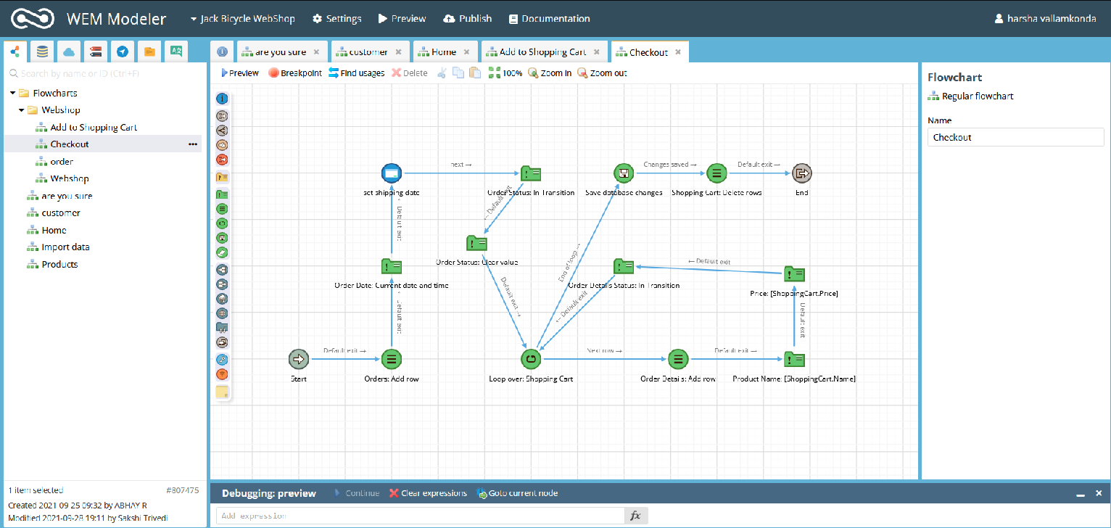
Design Phase

Slide 11
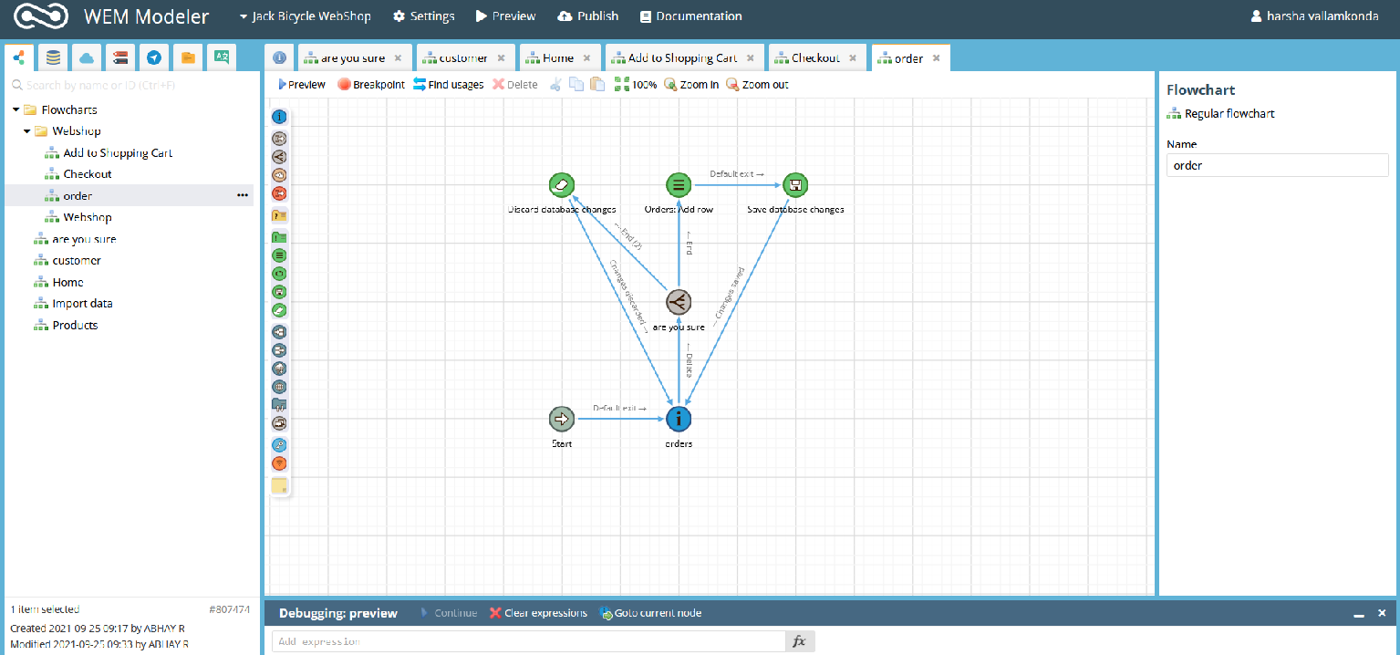
Design Phase (Contd)

Slide 12
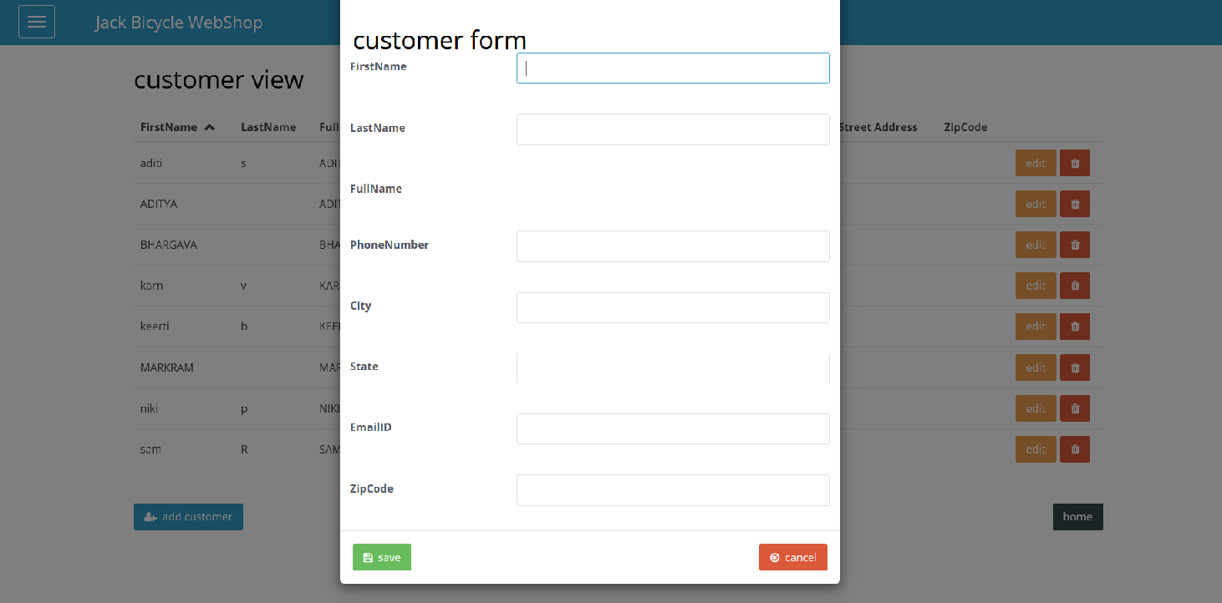
Output

Slide 13
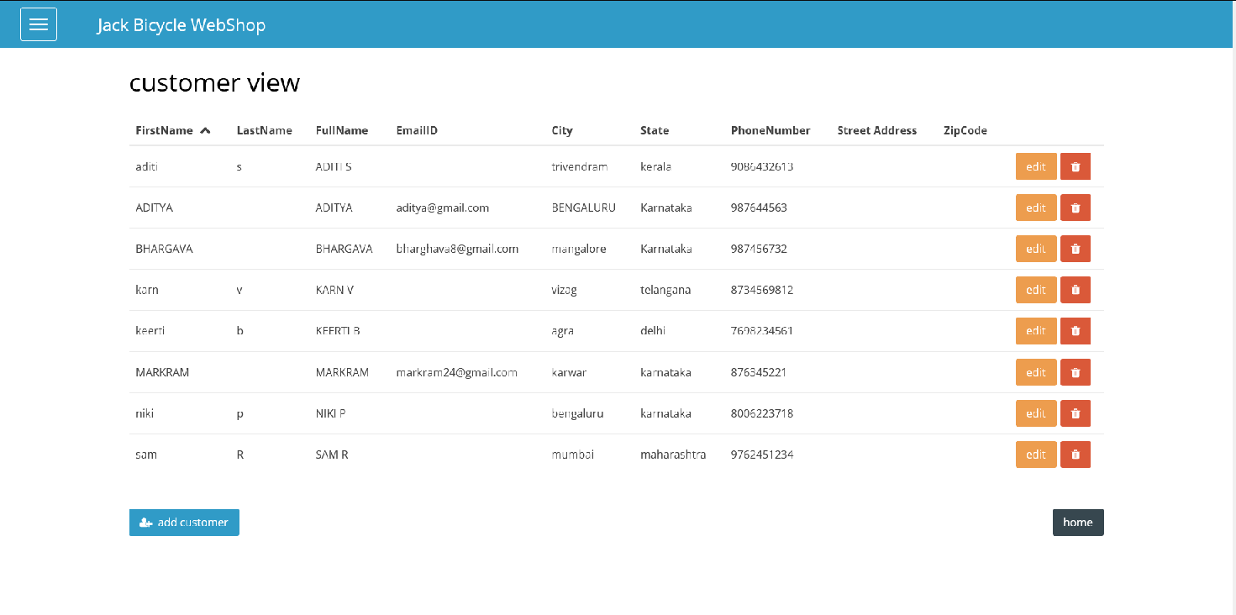
Output (Contd)

Slide 14
References
https://www.google.com/url?sa=t&rct=j&q=&esrc=s&source=web&cd=&cad=rja&uact=8&ved=2ahUKEwiRi5i04__0AhUBheYKHaHHDCcQFnoECAYQAQ&url=https%3A%2F%2Fwww.creatio.com%2Fpage%2Flow-code&usg=AOvVaw2UWvpqAFtogPedPEG7ZaAD
https://www.google.com/url?sa=t&rct=j&q=&esrc=s&source=web&cd=&cad=rja&uact=8&ved=2ahUKEwiRi5i04__0AhUBheYKHaHHDCcQFnoECGEQAw&url=https%3A%2F%2Fresearch.aimultiple.com%2Flow-code-statistics%2F&usg=AOvVaw3a5aus_8mv9rZHpieCjEaX
https://wem.io/documentation/
https://wem.io/
https://whimsical.com/e-commerce-5CAL1x6H6kLRQUD4S8zmqj

